Slide 1

Lending Club Case Study
Milton Nepoli A

Slide 2
Problem Statement
To understand the driving factors (or driver variables) behind loan default, i.e., the variables which are strong indicators of becoming a default
The company can utilize this knowledge for its portfolio and risk assessment

Slide 3
Loan Dataset
Loan Accepted: if company approves the loan, there are 3 possible scenarios described below:
Fully paid: Applicant has fully paid the loan (the principal and the interest rate)
Current: Applicant is in the process of paying the instalments, i.e., the tenure of the loan is not yet completed. These candidates are not labelled as 'defaulted'
Charged-off: Applicant has not paid the instalments in due time for a long period of time, i.e., he/she has defaulted on the loan
Loan rejected: The company had rejected the loan (because the candidate does not meet their requirements etc.). Since the loan was rejected, there is no transactional history of those applicants with the company and so this data is not available with the company (and thus in this dataset)

Slide 4
Problem Solving Methodology
How consumer attributes and loan attributes influence the tendency of defaulter
Using EDA for this analysis
Data Cleaning
Data Understanding
Univariate Analysis
Segmented Analysis
Bivariate Analysis

Slide 5
Analysis

Slide 6
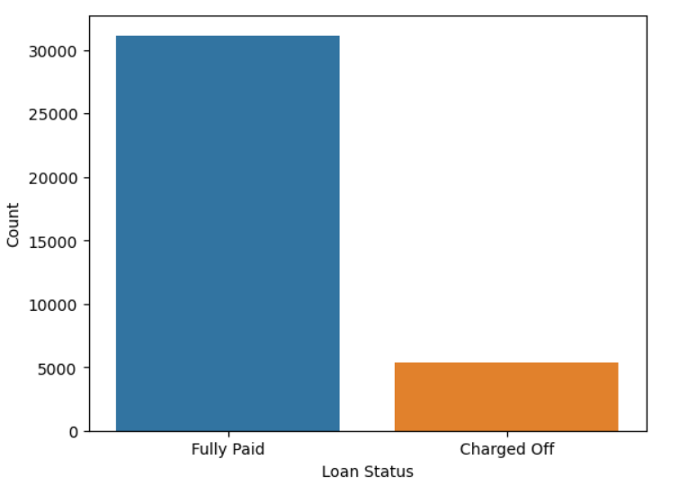
Split of Fully Paid vs Charged Off

Slide 7
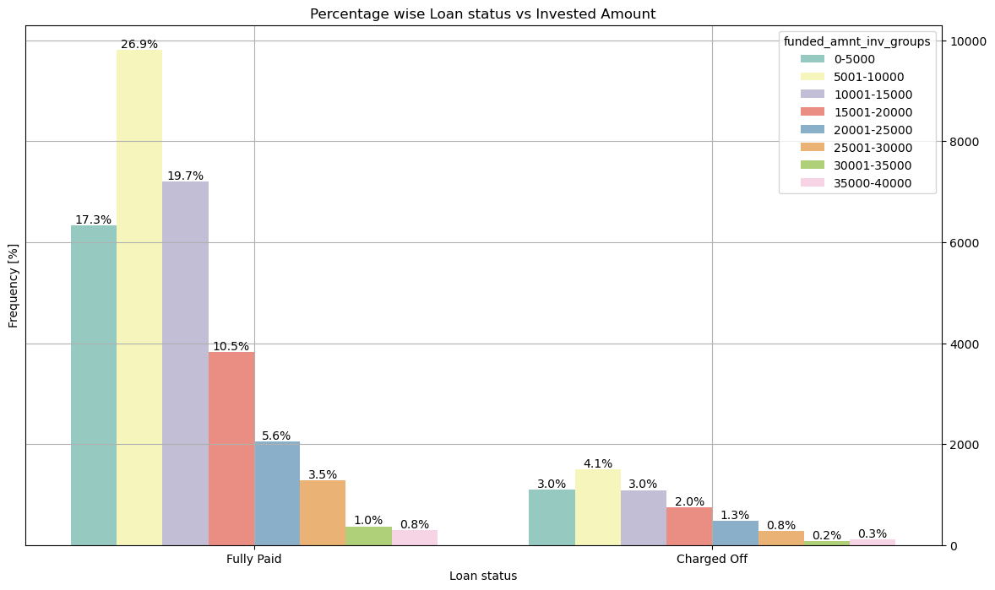
Loan Status vs Invested Amount
I see funded amount invested is positively correlated with both Charged off and Fully Paid
I see that Employees who have exp 10+, 0, 2 & 3 years are likely to become Defaulters

Slide 8
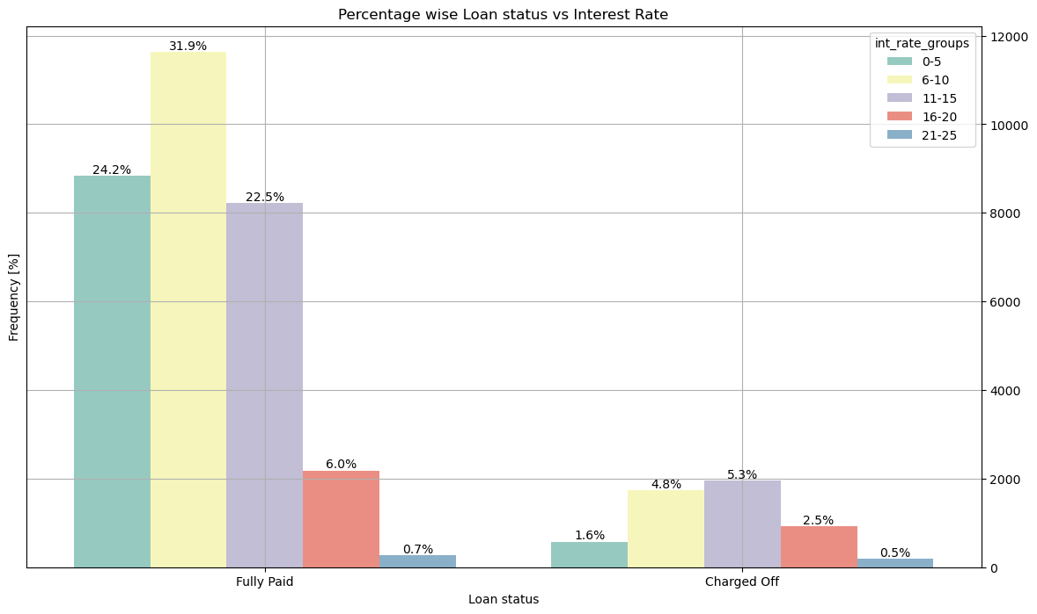
Loan Status vs Interest Rate
I see annual income is positively correlated with both Charged off and Fully Paid
I also see if annual income is in range of 40001 to 60000 then chances of becoming defaulter is higher
Looking at the ratio of, say charged off vs Fully Paid say for 0-20000, has higher chances of becoming defaulter

Slide 9
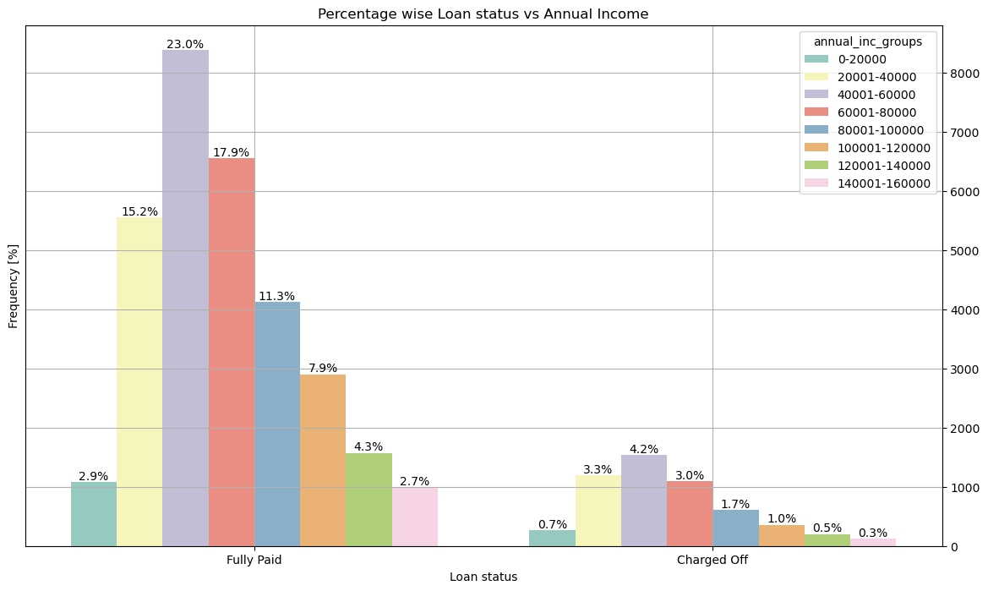
Loan Status vs Annual Income
I see annual income is positively correlated with both Charged off and Fully Paid
I also see if annual income is in range of 40001 to 60000 then chances of becoming defaulter is higher
Looking at the ratio of say charged off/ Fully Paid --> say for 0-20000, 0.7/2.9 nearly = 24.13 has higher chances of becoming defaulter

Slide 10
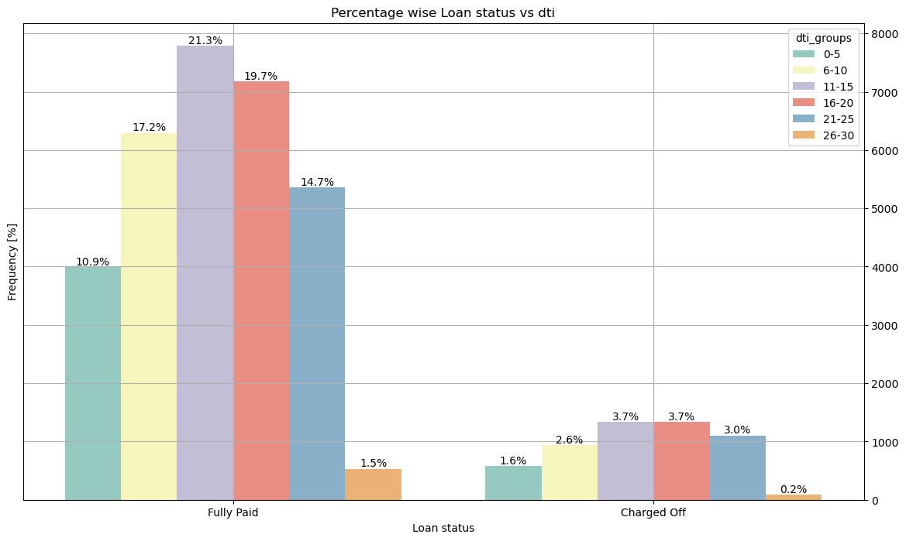
Loan Status vs DTI
I see DTI is positively correlated with both Charged off and Fully Paid
I also see if DTI is in range of either 11 to 15 or 16-20 then chances of becoming defaulter is higher

Slide 11
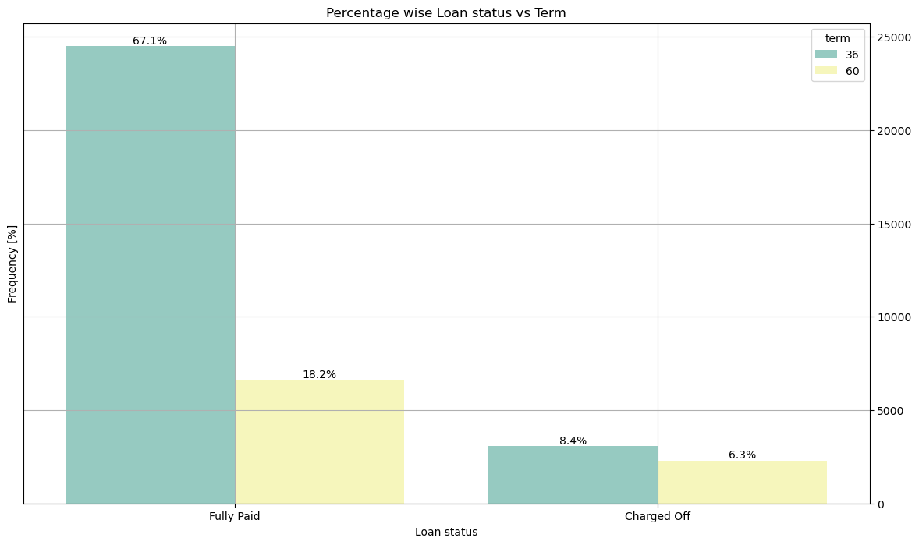
Loan Status vs Term
I see term is positively correlated with both Charged off and Fully Paid
I also see if term is 36 months, then chances of becoming defaulter is higher
But ratio wise 60 months has much higher number

Slide 12
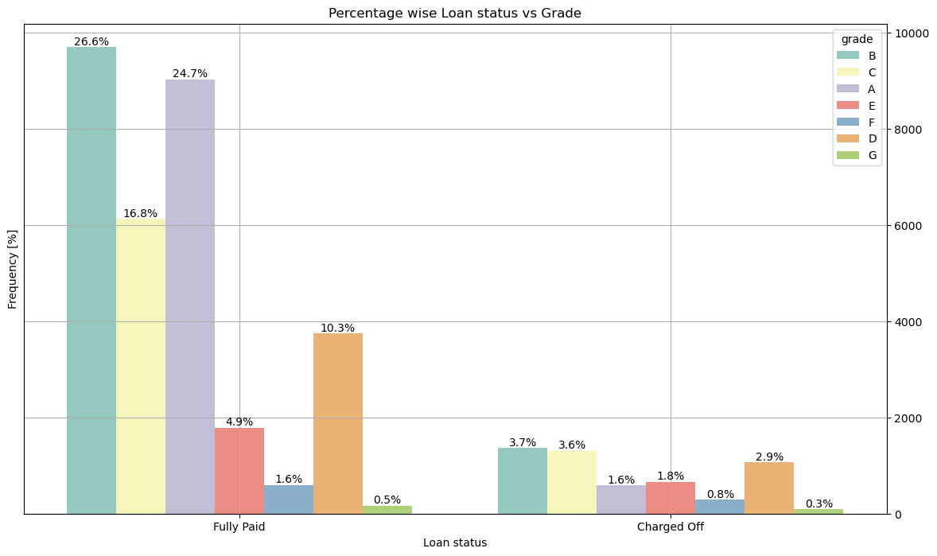
Loan Status vs Grade
I see term is positively correlated with both Charged off and Fully Paid
I also see if grade is B then chances of becoming defaulter is higher
But ratio wise G has higher chances of being defaulter

Slide 13
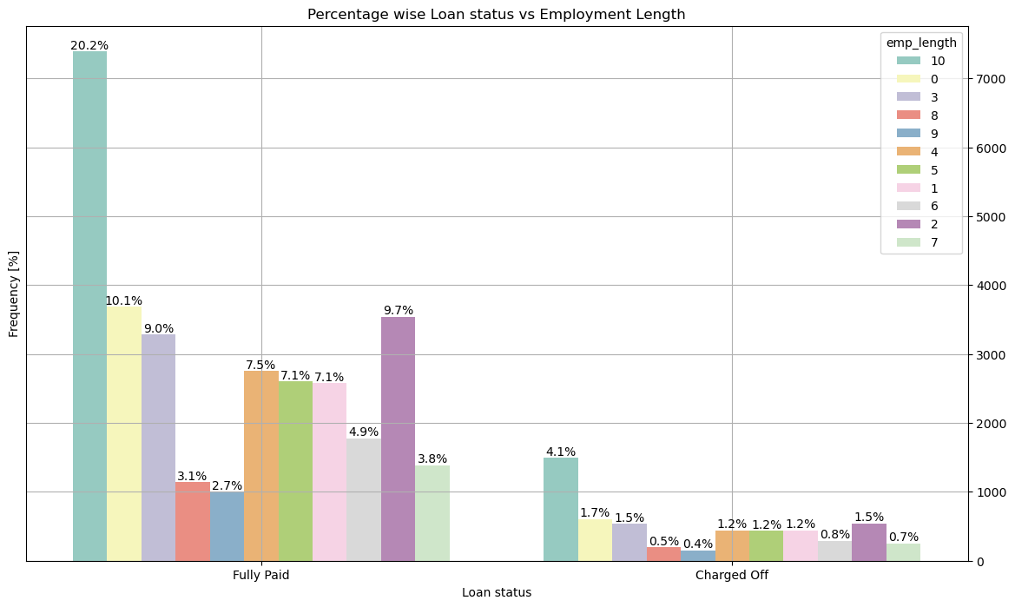
Loan Status vs Employment Length
I see emp length is positively correlated with both Charged off and Fully Paid
# Basically, emp length may not be a good criteria to detect defaulters
Also, I see that Employees who have exp 10+, 0, 2 & 3 years are likely to become defaulters

Slide 14
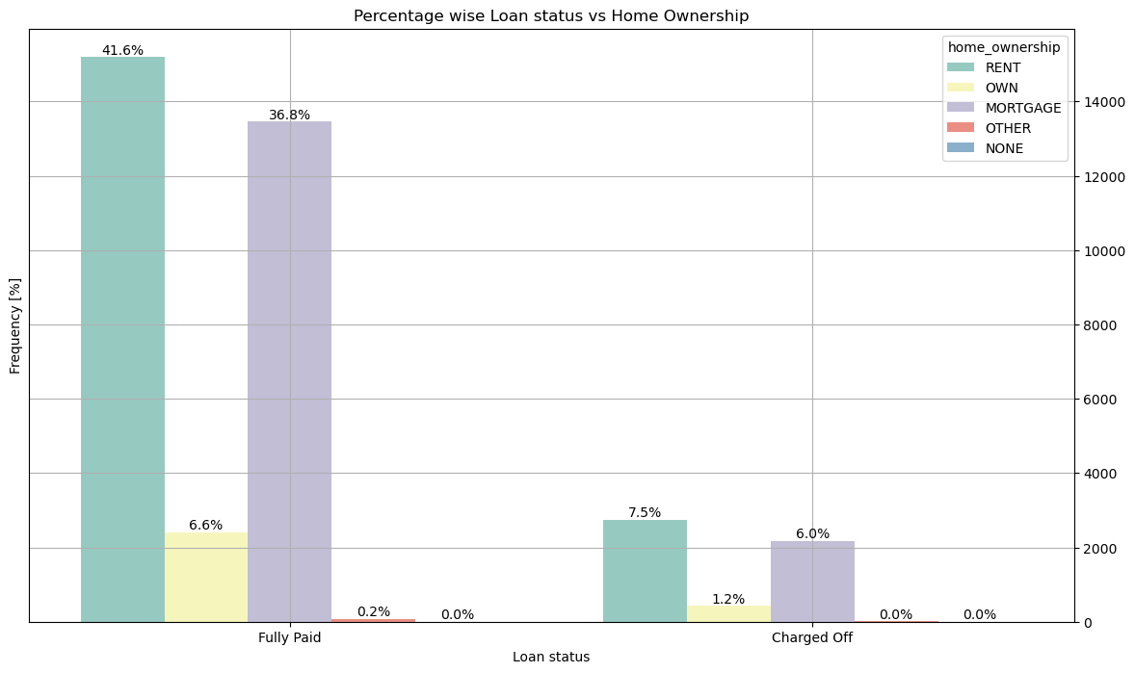
Loan Status vs Home Ownership
I see home ownership is positively correlated with both Charged off and Fully Paid
I also see if home ownership is either RENT or MORTGAGE then chances of becoming defaulter is higher

Slide 15
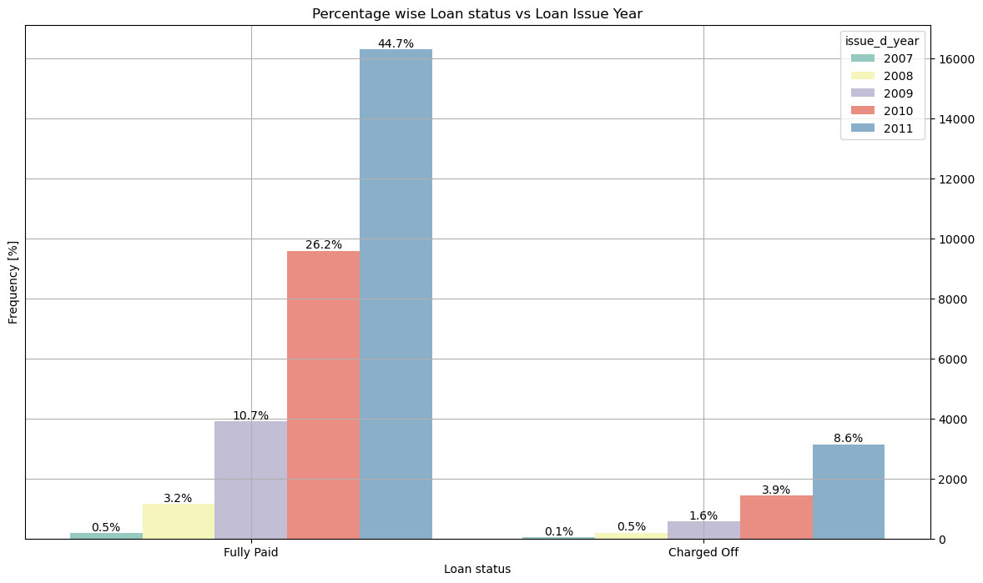
Loan Status vs Loan Issue Year
I see issue year is positively correlated with both Charged off and Fully Paid
I also see if issue year is 2011 then chances of becoming defaulter is higher

Slide 16
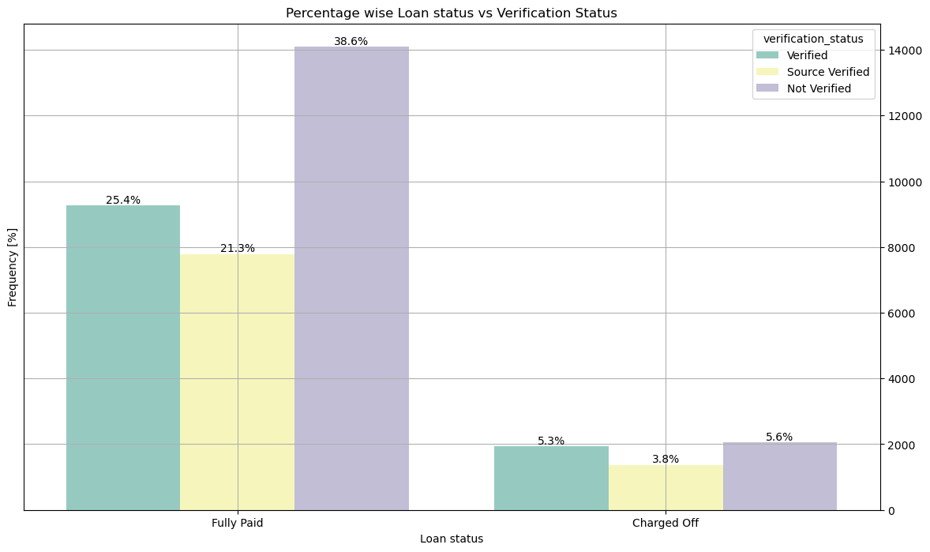
Loan Status vs Verification Status
I see verification status is positively correlated with both Charged off and Fully Paid
I also see if verification status is not verified then chances of becoming defaulter is higher
But percentage wise verified also has higher chances of being defaulter

Slide 17
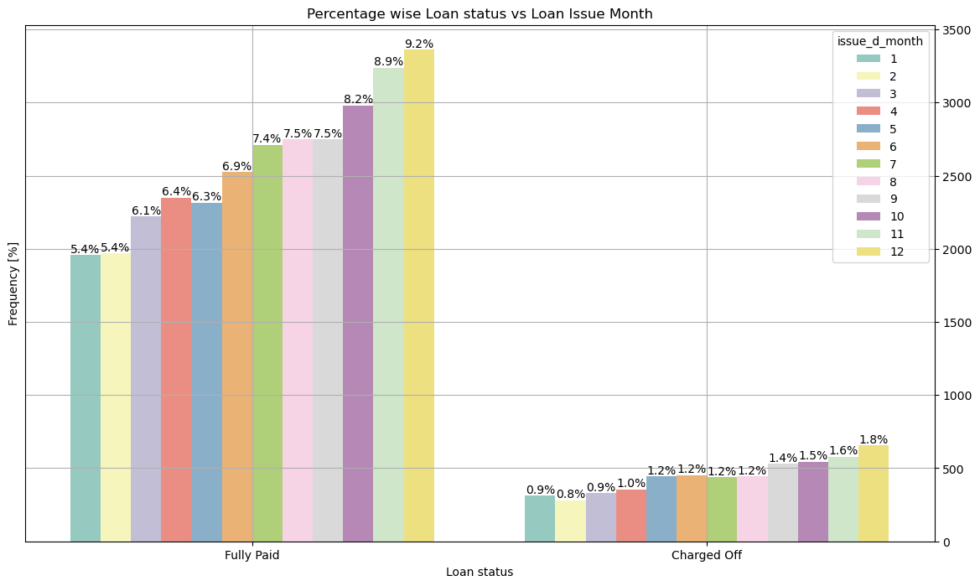
Loan Status vs Loan Issue Month
I see issue month is positively correlated with both Charged off and Fully Paid
# I also see if issue month is either Dec or Nov then chances of becoming defaulter is higher

Slide 18
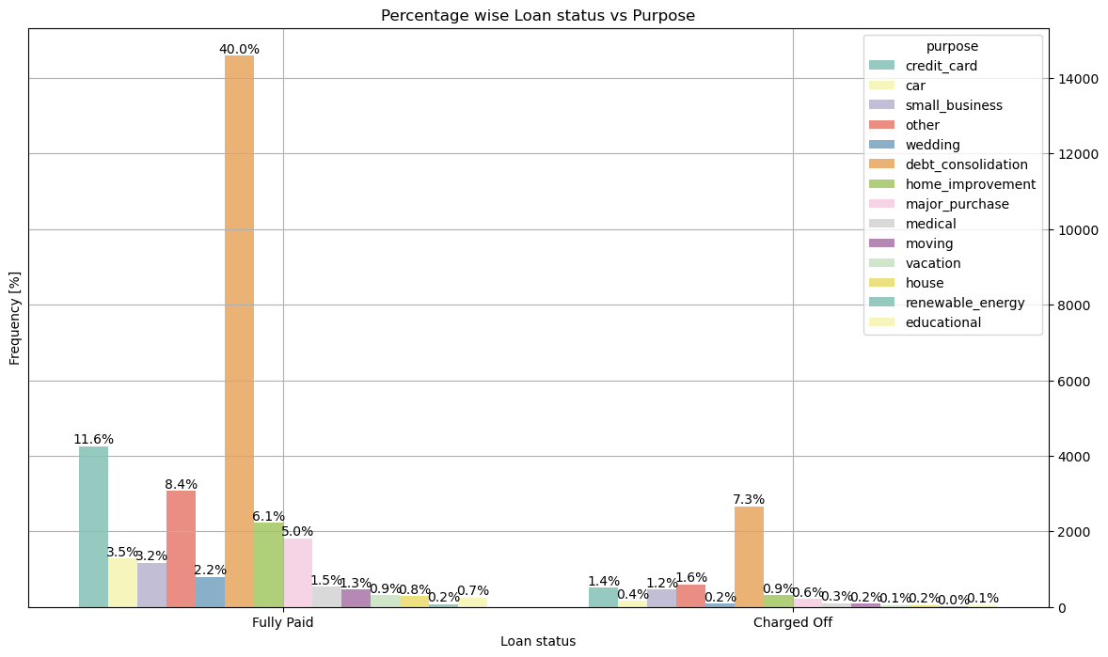
Loan Status vs Purpose
I see purpose is positively correlated with both Charged off and Fully Paid
I also see if purpose is debt consolidation then chances of becoming defaulter is higher

Slide 19
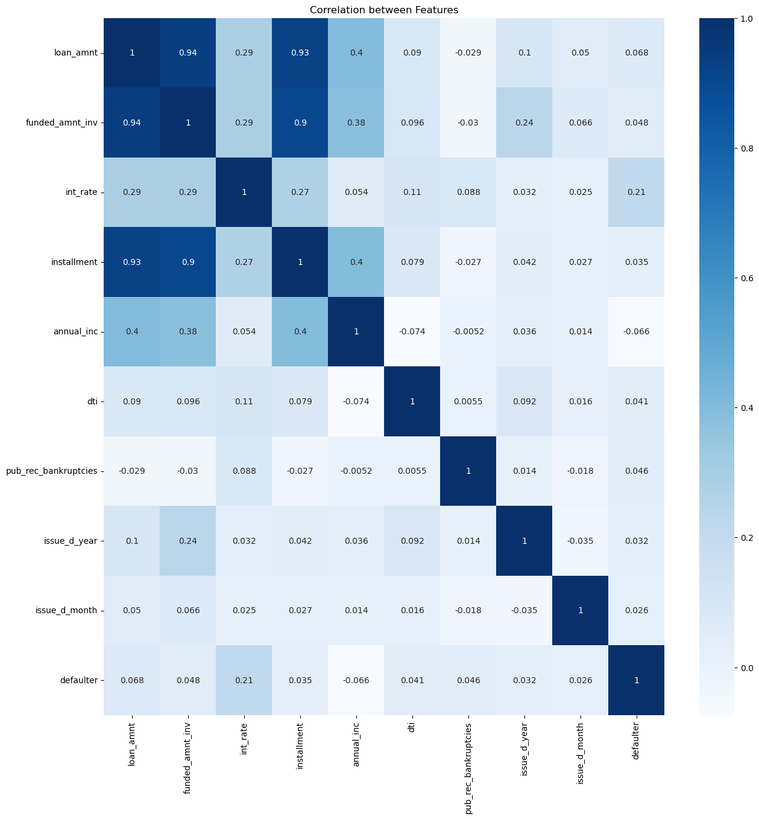
Correlation

Slide 20
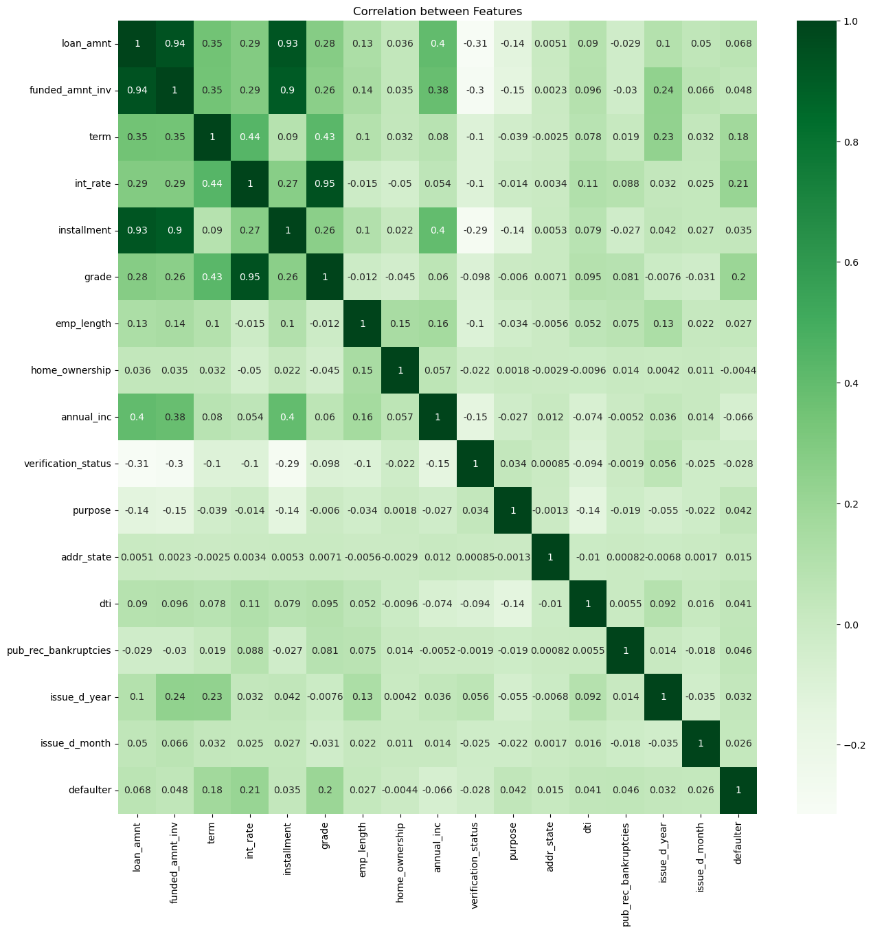
Correlation between Features

Slide 21
Conclusion
Based on heatmap it is observed that home_ownership, annual_inc and verification_status with defaulter are negatively correlated,
If home_ownership is RENT or Mortgage, then chances of becoming defaulter is higher
If verification_status is verified, then chances of becoming defaulter is higher
For Annual income - Looking at the ratio of say charged off/ Fully Paid - say for 0-20000 range, 0.7/2.9 nearly = 24.13 has higher chances of becoming defaulter. Heatmap is also confirming this
Term, int_rate, grade are positively correlated,
A. So higher the term greater will be chances of becoming defaulter - 60 months
B. Higher the int_rate means higher the chances of becoming defaulter - 21-25%
C. Higher the grade means higher the chances of becoming defaulter - G

